Slide 1

JCAPS 5.1 FileToFile POC
Phani Krishna

Slide 2
File to File Scenario
Components Required
  Connectivity Map
  Java Collaborations
  Deployment Profile
  External Systems

Slide 3
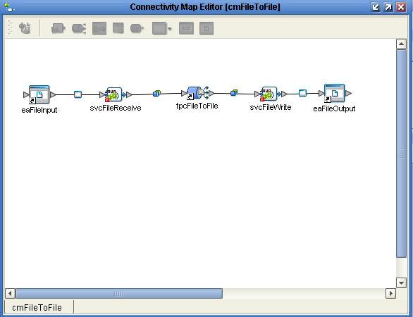
Connectivity Map

Slide 4
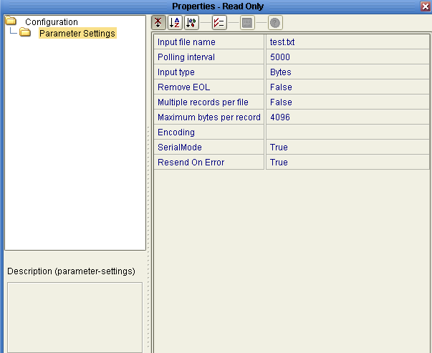
Inbound File Parameter Settings
( eaFileInput -> svcFileReceive)

Slide 5
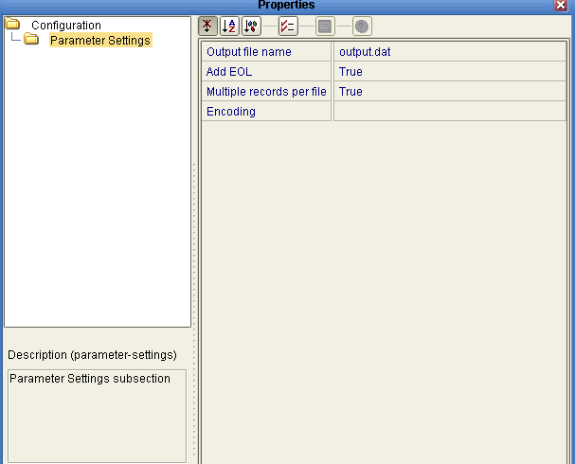
Outbound File Parameter Settings
(svcFileWrite -> eaFileOut)

Slide 6
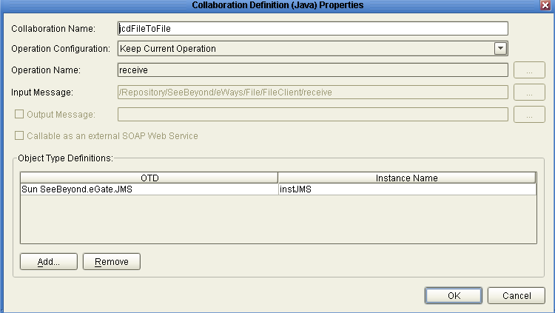
Java Collaboration
(svcFileReceive)

Slide 7
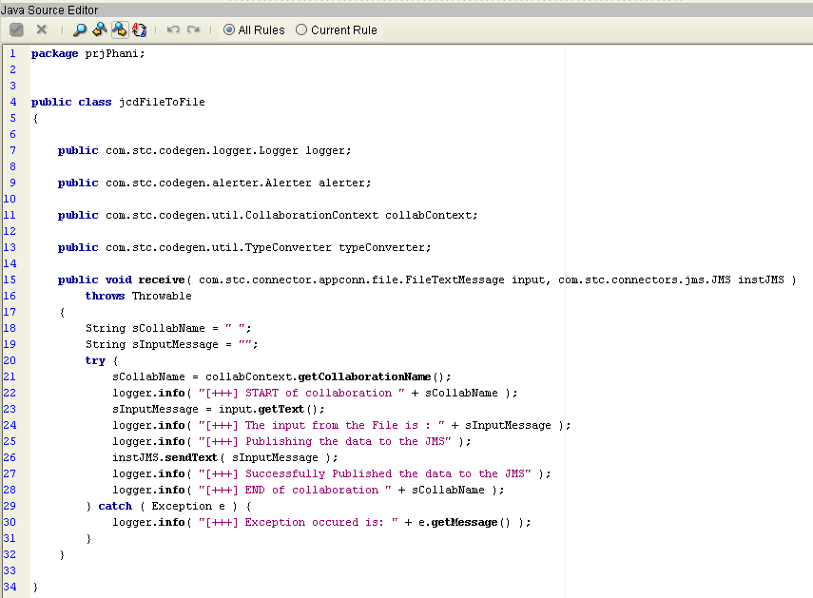
Jcd Code
(svcFileReceive)

Slide 8
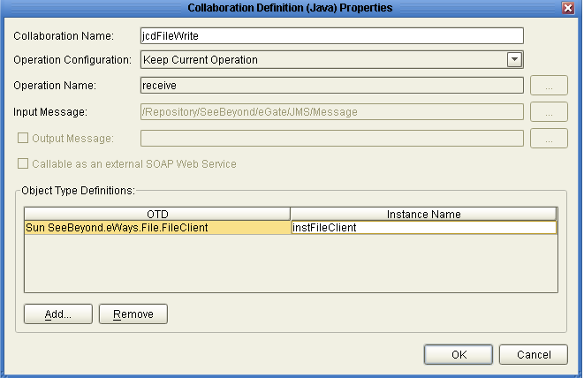
Java Collaboration
(svcFileWrite)

Slide 9
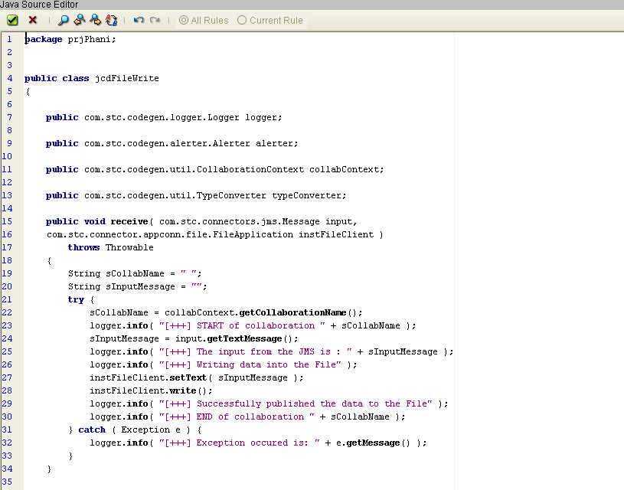
Jcd Code
(svcFileWrite)

Slide 10
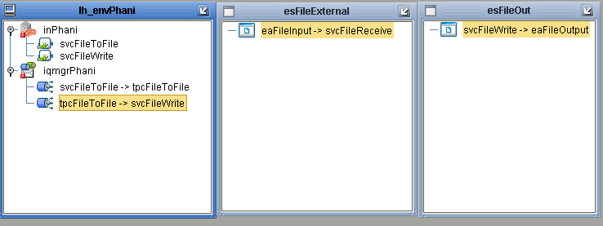
Deployment Profile
(dpFileToFile)

Slide 11
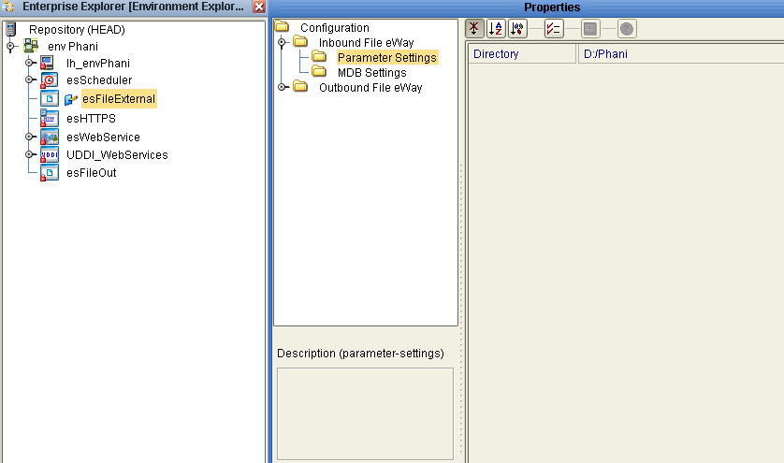
External System - esFileExternal
(Inbound FileConfiguration)

Slide 12
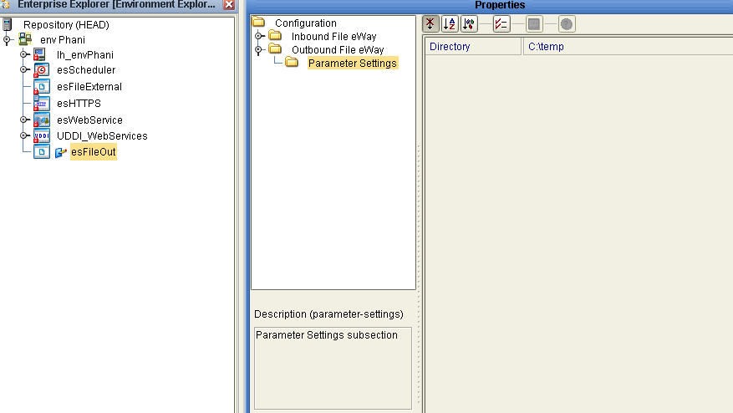
External System - esFileOut
(Outbound File Configuration)

Slide 13
Thank You
Phani Krishna

